Slide 1
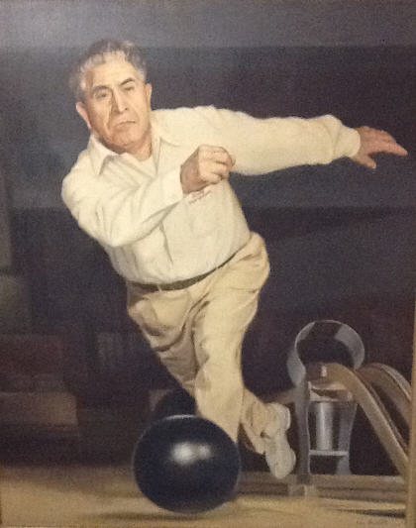
Andy Varipapa
Hall Of Fame Exhibit 2018

Slide 2
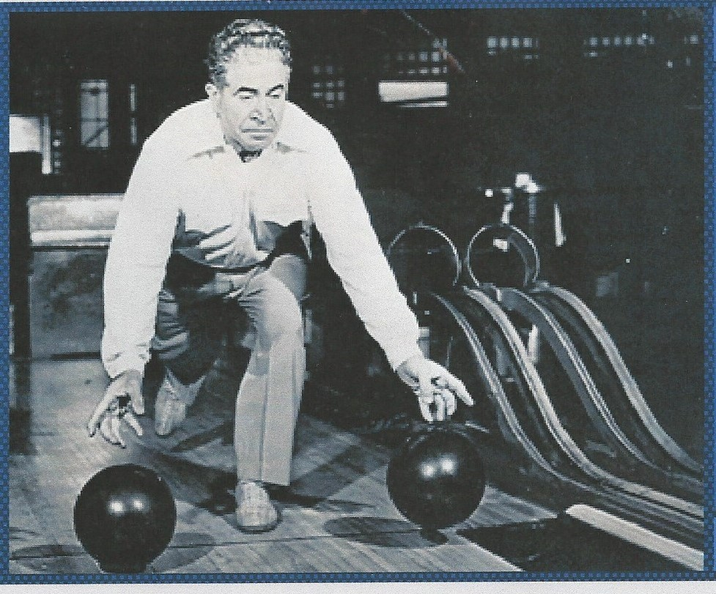
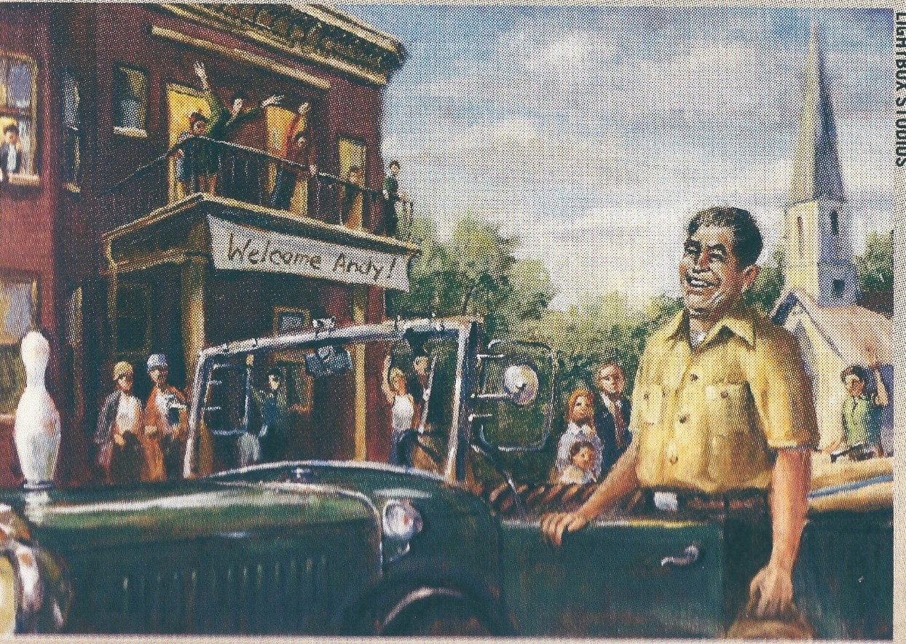
Andy Varipapa had become a well-known bowler in New York after winning numerous local championships in the 1930’s. But it was the mastery of his trick shots that made him famous. The BPAA and Brunswick sponsored an exhibition tour across America with the top bowlers of the day, which helped to make Andy a nationwide household name. It was usually front page news when Andy came to town.
Image and photo from Bowlers Journal and family archives, portrait by Mort Luby Jr.

Slide 3
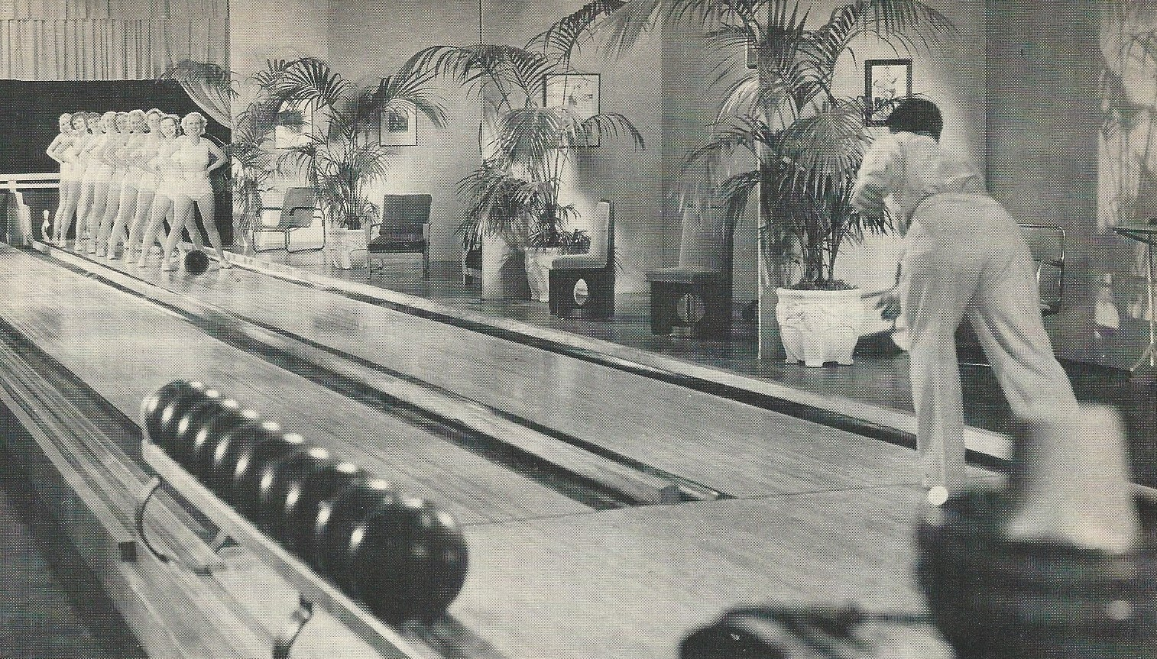
Andy’s popularity quickly came to the attention of the movie studios. Hollywood came calling, producing Andy’s first of 17 bowling films, “Strikes and Spares,” in 1934. Many of his trick shots became famous, such as rolling the ball between the legs of 10 showgirls on the way to converting a spare. This photo would be reproduced as an ad for Brunswick when they celebrated Andy’s 90th birthday in 1981. Two more films would be produced in the 1930’s – “Skittle Wizardry” in the UK in 1937 as Andy became known in Europe, and “Set ’Em Up” with fellow pro Ned Day in 1939.
Photos from museum collection

Slide 4
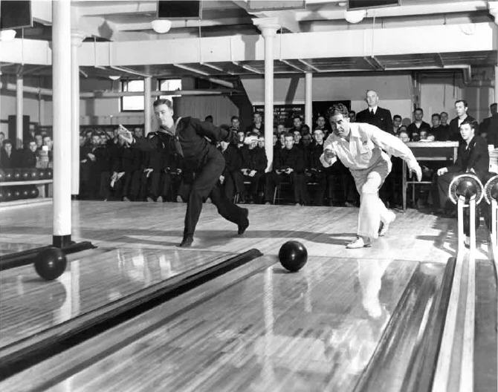
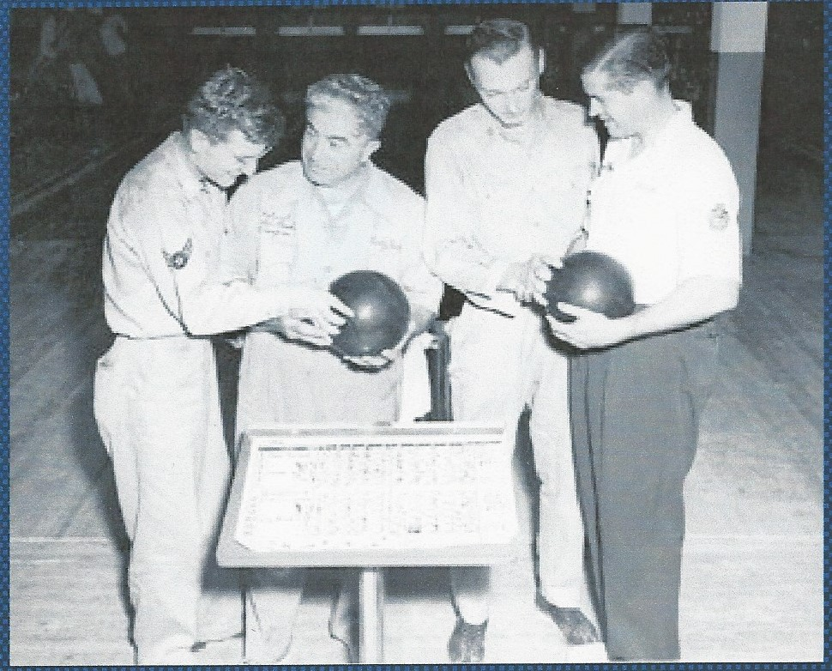
In the 1940’s Andy continued to bowl competitively as well as tour the country giving exhibitions, but with the onset of WW2 he signed on as a representative of the U.S. Treasury to help stimulate the sales of War Bonds & Stamps. In addition to visiting Army and Navy bases in America to bowl with the soldiers and sailors, Andy and fellow Hall of Famer Joe Norris toured the U.S. military bases in Europe to entertain the troops.
Photos from museum collection

Slide 5
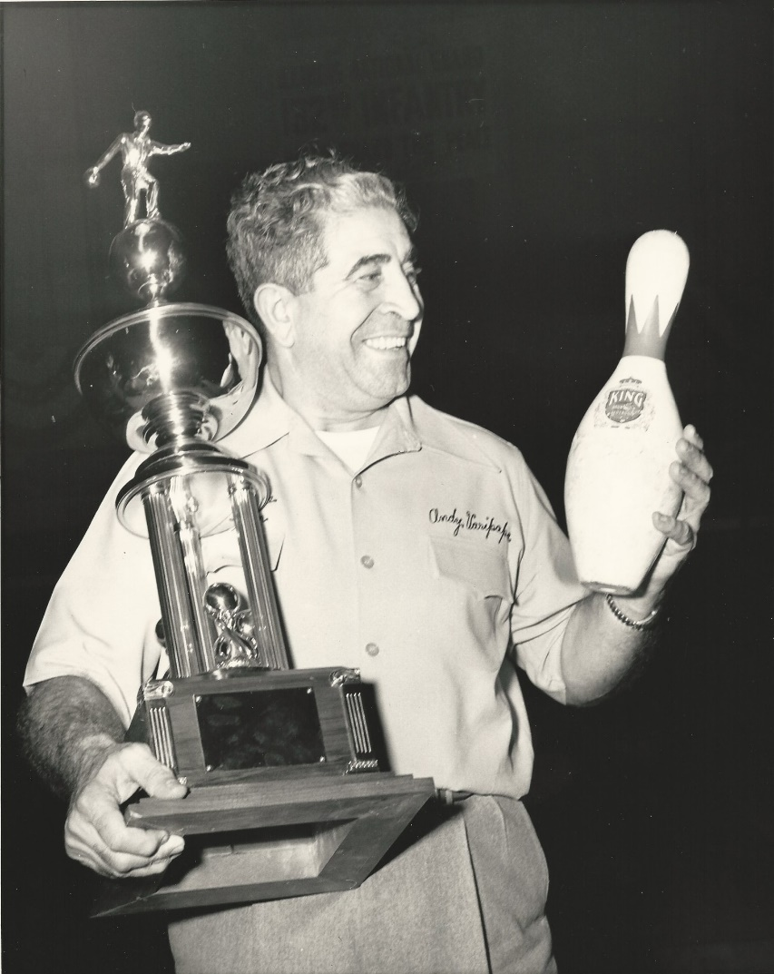
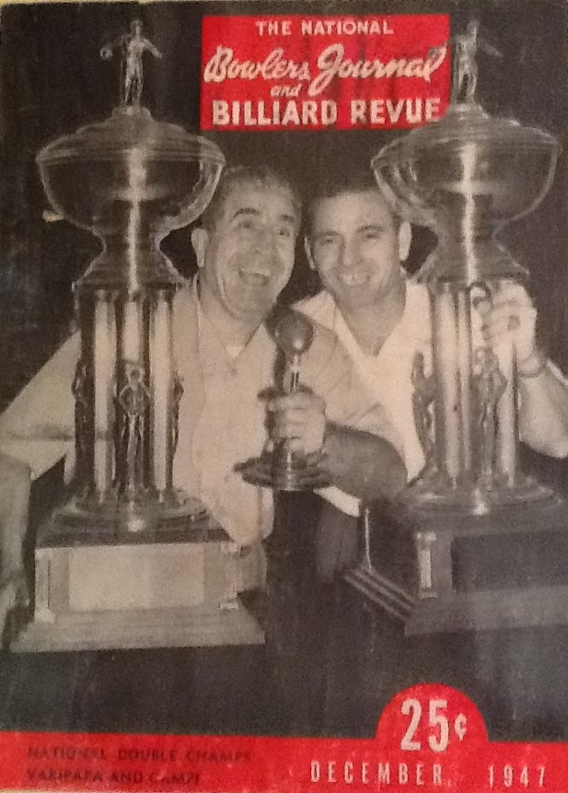
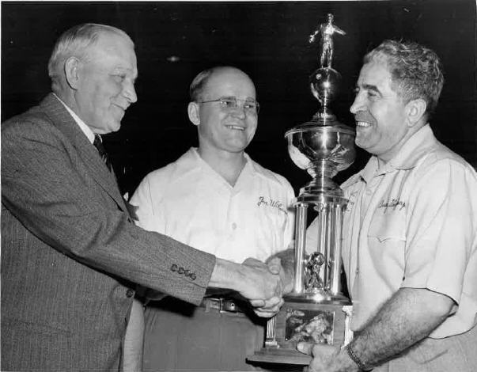
With the war coming to an end, Andy continued his quest to become recognized as the National Champion and in 1946 at age 55 he became the oldest bowler to win the BPAA All-Star. After the victory President Truman invited him to the White House. He followed that up with winning again in 1947, defeating fellow Hall of Famer Joe Wilman to become the first to notch back-to-back victories. He would finish second in the 1948 All-Star, a three-year All-Star/U.S. Open performance as yet unmatched. Andy also won the National Doubles title in 1947 and 1948 with fellow Hall of Famer Lou Campi, and was voted Bowler of the Year in 1948.
Photos from museum collection and family archives

Slide 6
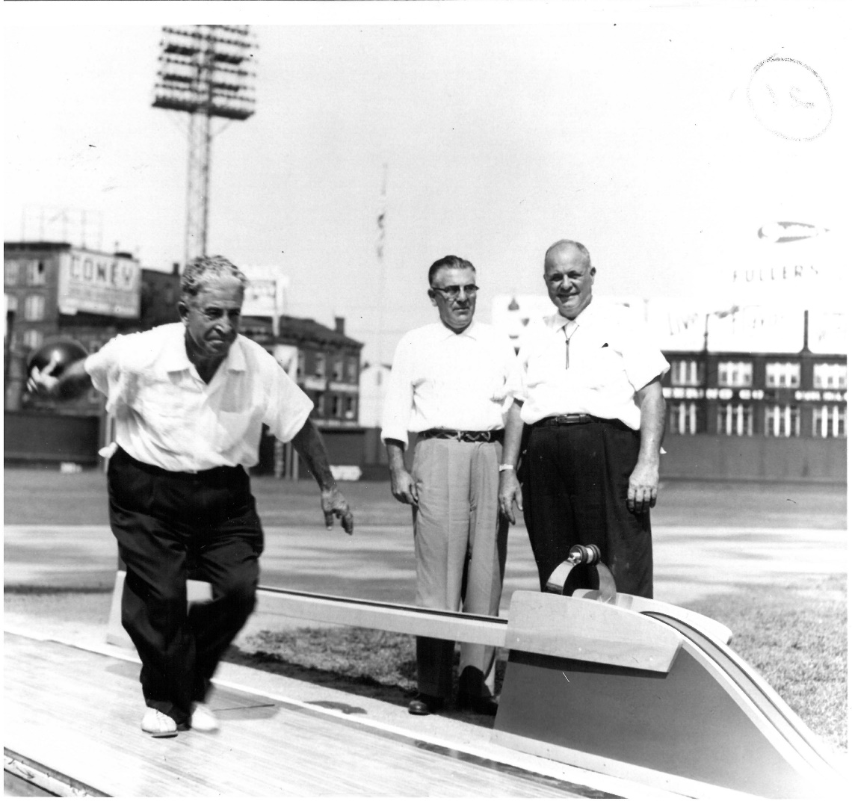
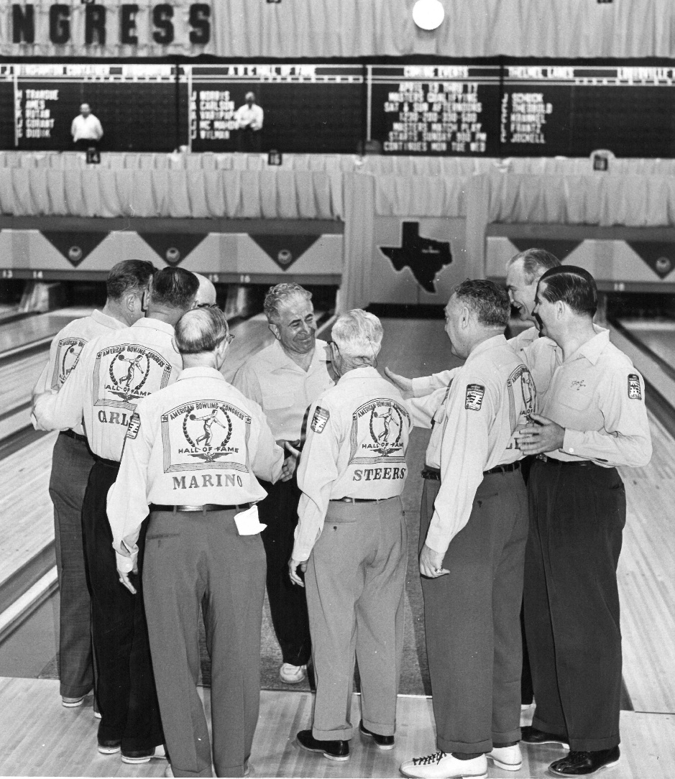
Andy continued to bowl competitively through the 1950’s, finishing second in the ABC Masters in 1952 at age 61. But it was during this decade that he seemed to be everywhere. He had a full exhibition tour which included unique twists such as performing his trick shots on a special lane at Cincinnati’s Crossley field in 1955 before 34,000 fans at a Reds-Cardinals game. He was a guest on the popular TV show “What’s My Line,” and he appeared in ads for Pepsi-Cola and Equitable Life. Andy & Joe Norris once again toured Europe to entertain the troops. Surrounded by fellow pros, he was elected to the Hall of Fame in 1957.
Photos from museum collection

Slide 7
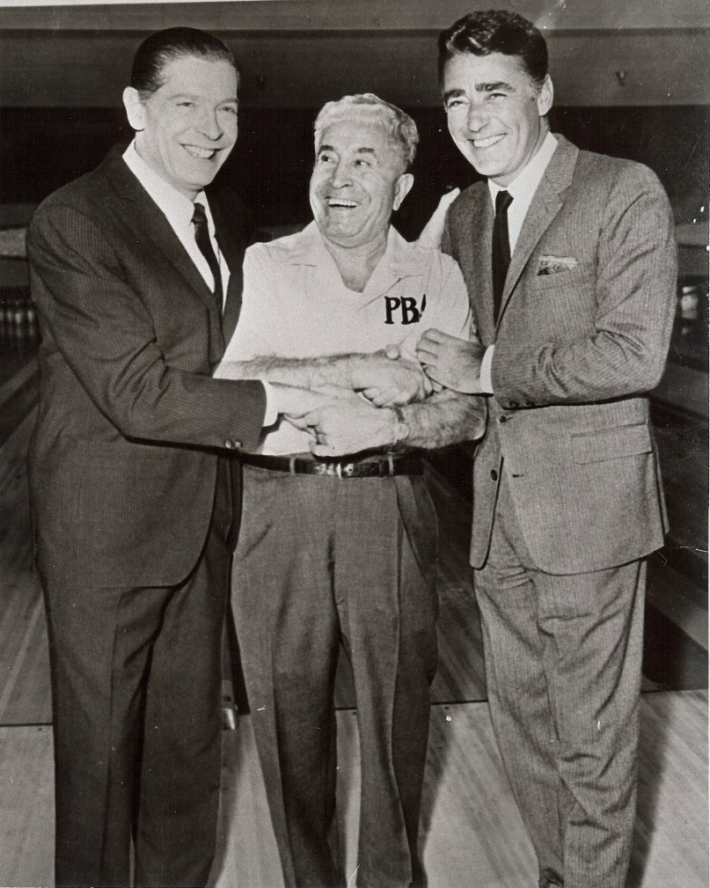
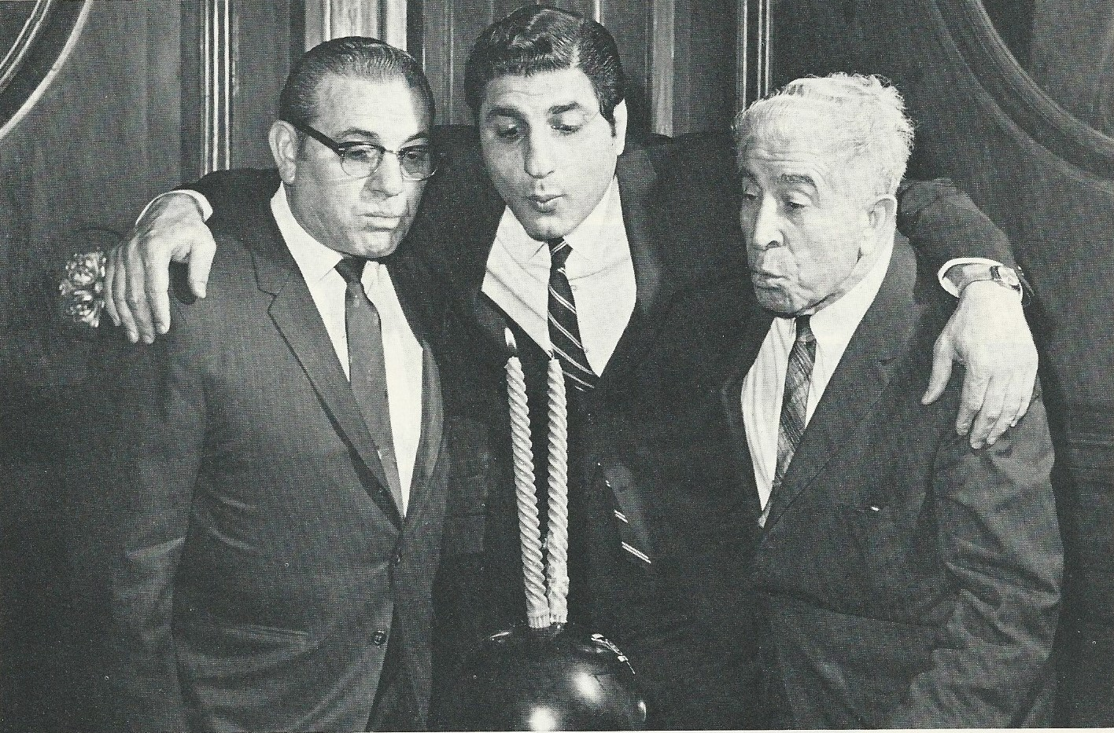
In 1959 Andy was among the second wave of bowlers to join the new Professional Bowlers Association. At age 68, Andy was at a competitive disadvantage with the new generation of stars like Don Carter and Dick Weber. Nevertheless, he was very supportive of the PBA and wanted to compete, and in that first year representing the PBA he became the only bowler to break the bank by throwing nine consecutive strikes on TV’s Jackpot Bowling, collecting $9,000 for the victory. He celebrated the second anniversary of the PBA Tour with Lou Campi and PBA founder Eddie Elias in 1961.
Photos from family archives

Slide 8
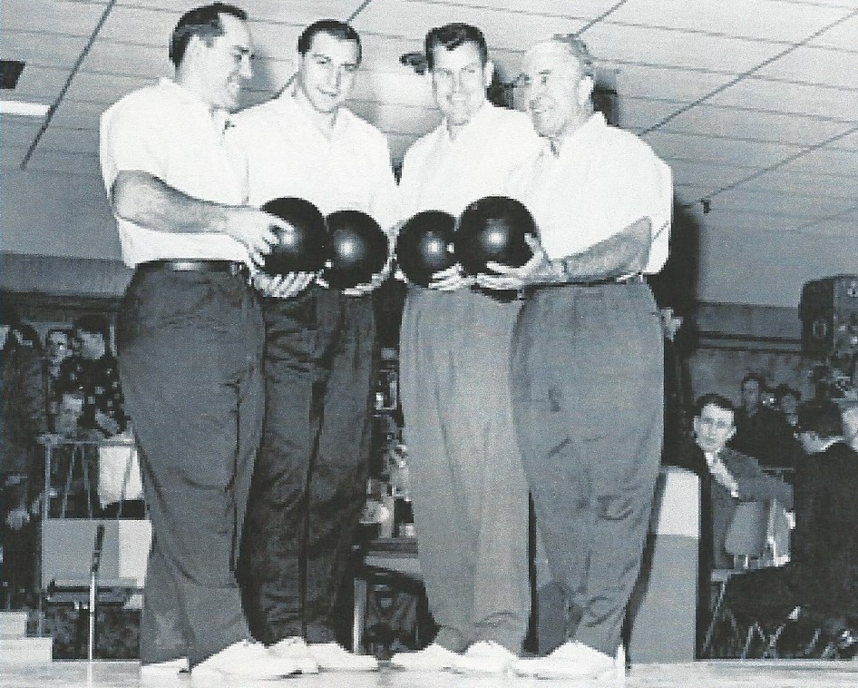
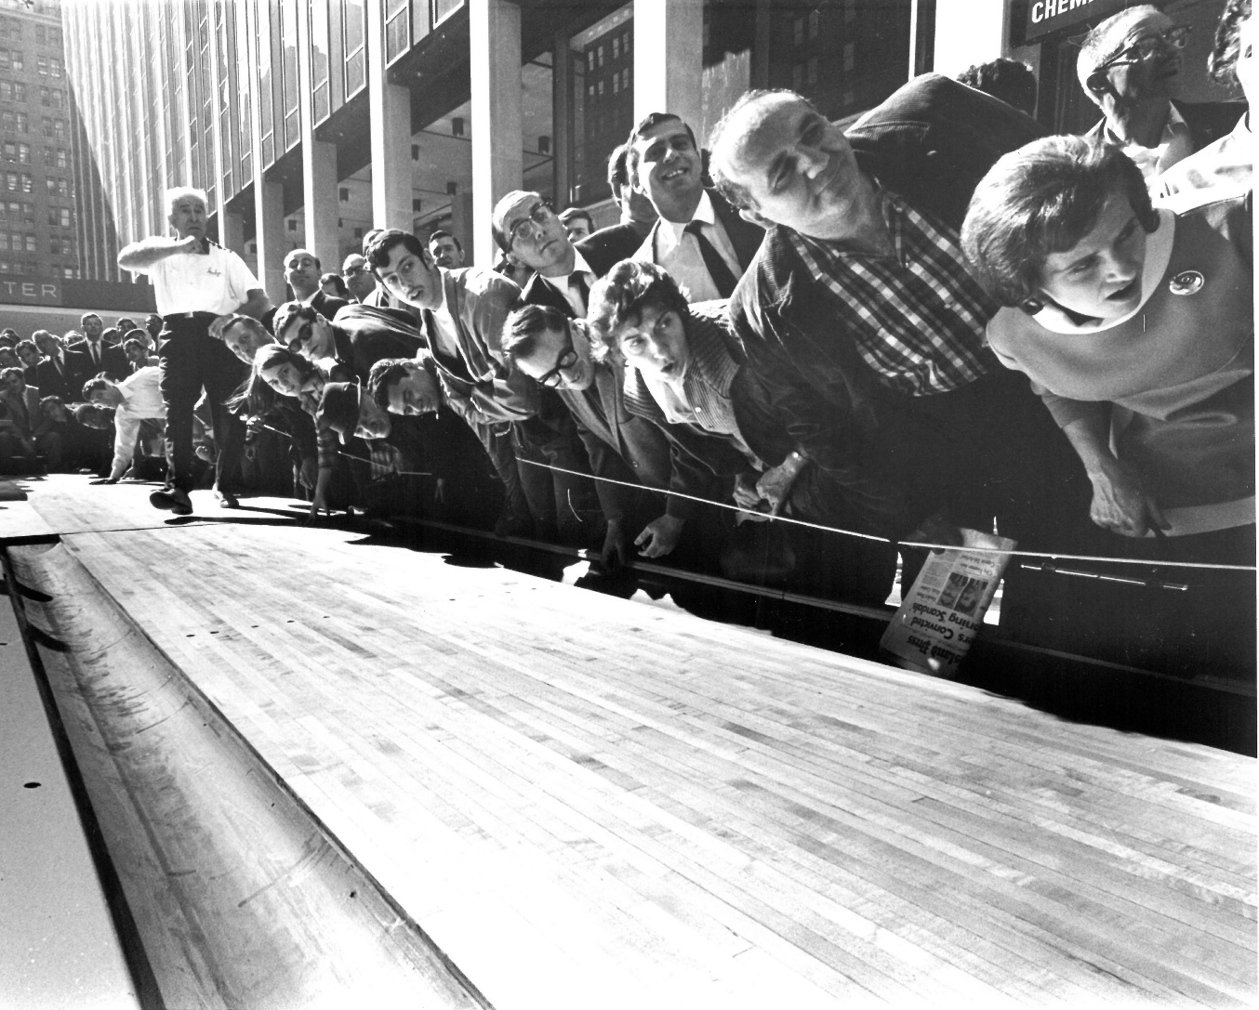
Andy toured the USA continuously in the 1960’s as a member of the Brunswick staff, giving exhibitions and making appearances on several TV shows including the CBS Sports Spectacular presentation “America Bowls,” where he gave pointers to sports stars Yogi Berra, Alan Ameche and Robin Roberts. He starred in a Schaefer beer commercial that ran nationally in 1965, and in that same year AMF sponsored Andy on a 14-country European exhibition tour that also included entertaining the U.S. Military at their bases in Germany. In 1968 he performed his trick shots for spectators on a special lane outside Madison Square Garden in New York City to promote the PBA National Championship.
Photos from museum collection and family archives

Slide 9
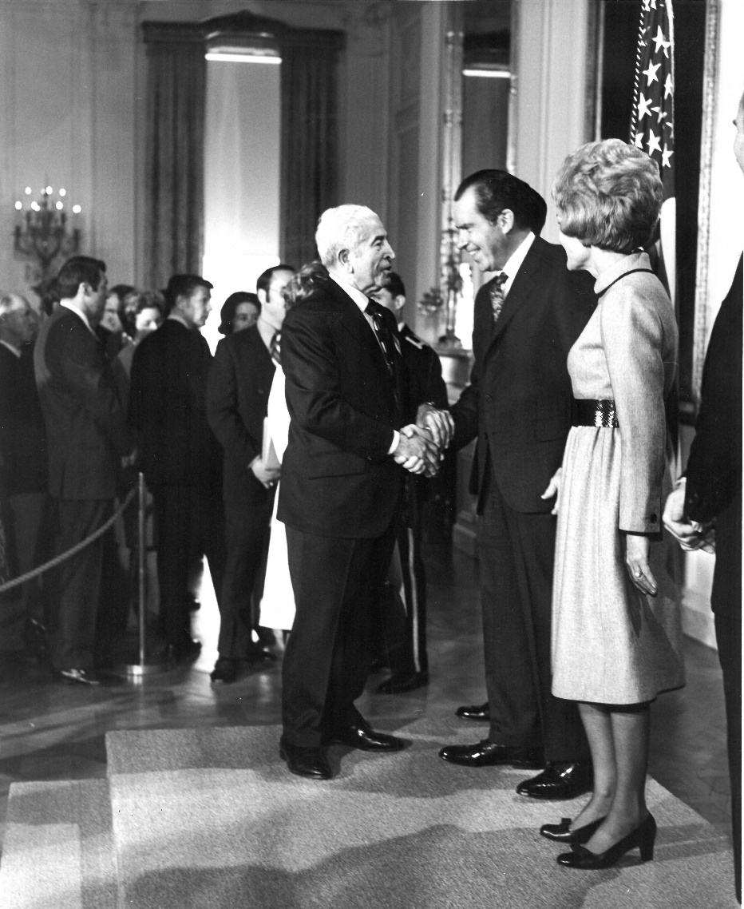
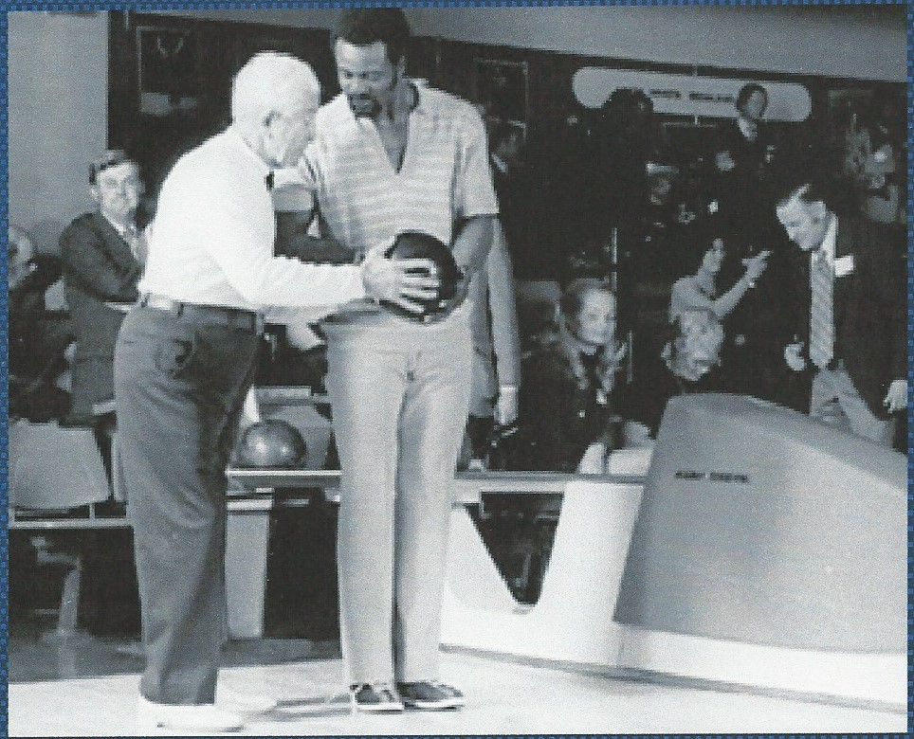
The 1970’s provided more special moments for Andy, including his appointment to the Council on Physical Fitness and Sports by
President Nixon in 1970. Nixon was an avid bowler and Andy gave him lessons both at the White House and Camp David. He was once again on TV during a segment of the special “Look Who’s Bowling,” giving pointers to the 1972 NFL Most Valuable Player, Washington Redskins running back Larry Brown. The National Bowling Council signed the now 84-year-old Andy to a contract touring the USA to promote bowling in 1974-75.
Photos from Museum collection and family archives

Slide 10
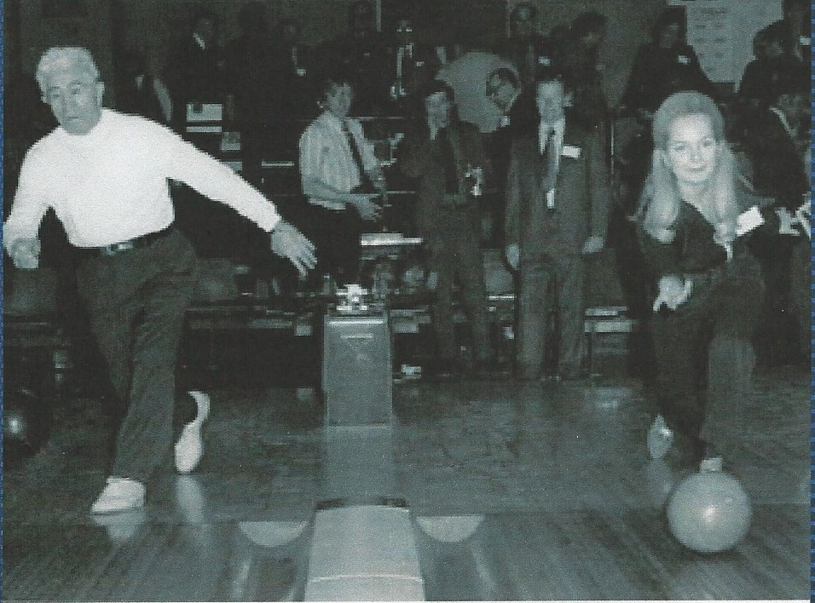
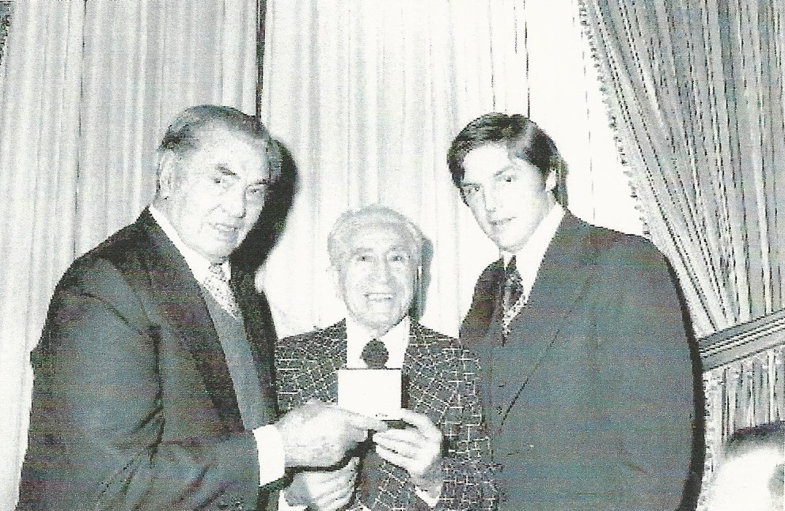
Andy remained active through the 1970’s. In addition to touring America for the National Bowling Council, he was also making appearances on behalf of the President’s Council on Physical Fitness and Sports along with Miss America 1969 Judi Ford, as they represented both the oldest and youngest members of the council. In 1976 he posed with Jack Dempsey and Tom Seaver as they all received the Hickok Golden Link Award as top professional athletes in their sport.
Photos from museum collection and family archives

Slide 11
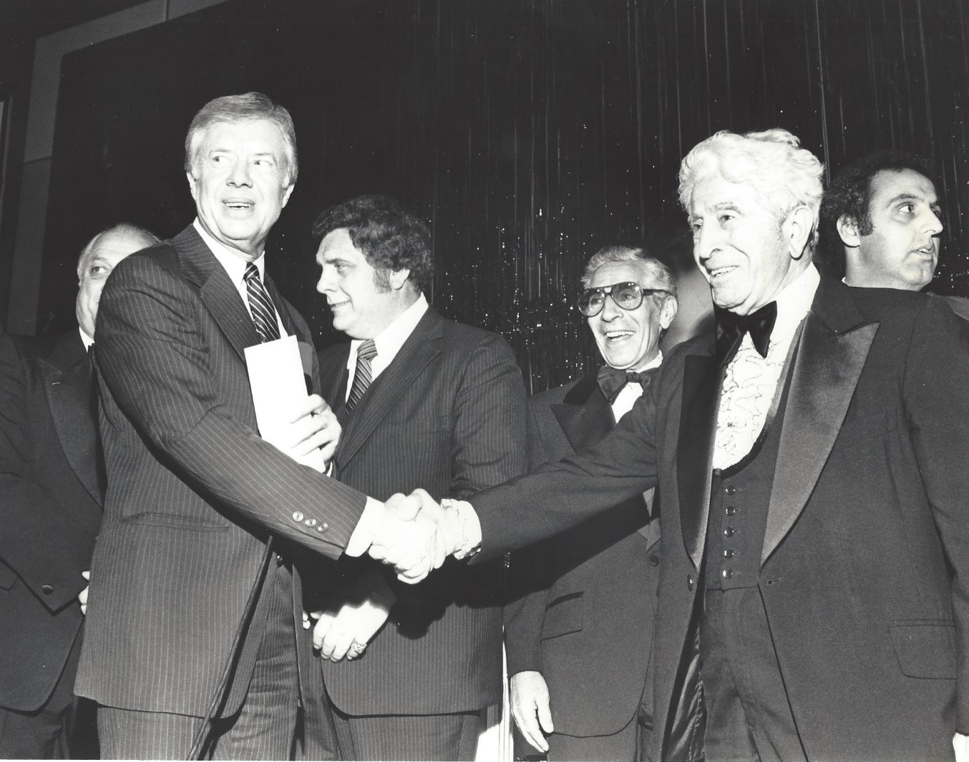
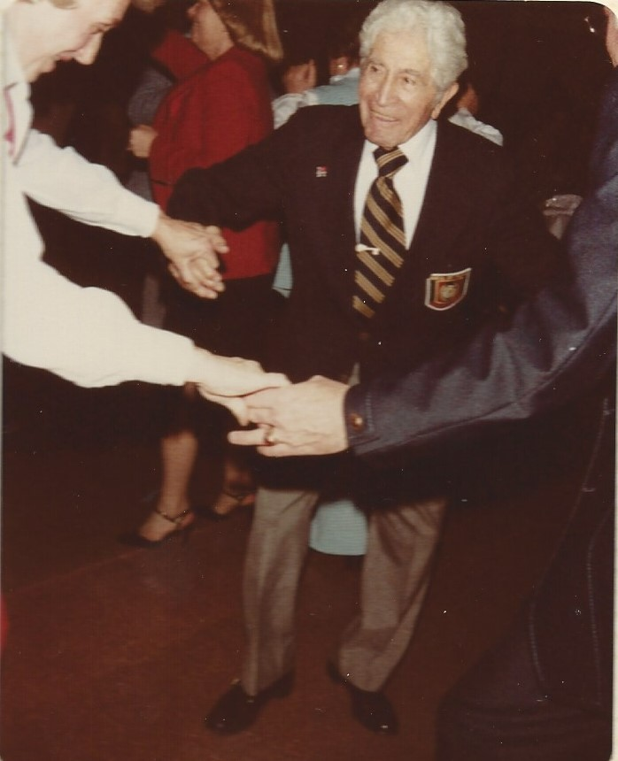
In November 1980 Andy was the first professional bowler inducted into the National Italian-American Sports Hall of Fame. On hand to perform the ceremony was President Jimmy Carter, the third U.S. President Andy met during his career. In 1981 Andy turned 90, and once again Hollywood came calling, featuring him performing his trick shots on the nationally televised show “That’s Incredible.” When the PBA Tour was in town that year, many pros including Hall of Famers Dick Weber, Carmen Salvino, and Earl Anthony celebrated with Andy at his birthday party. In 1988 Bowlers Journal posthumously voted Andy the “Man of the Century.”
Photos from family archives

Slide 12
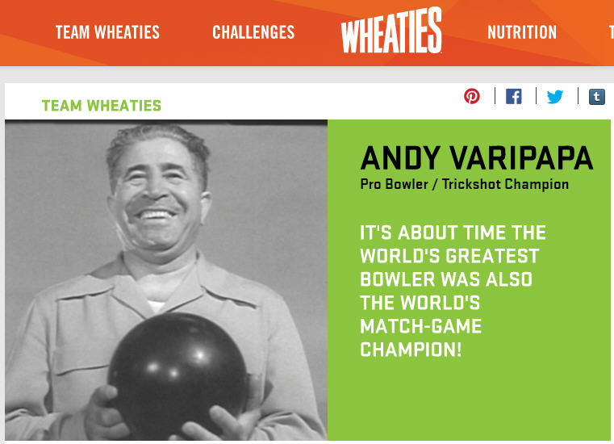
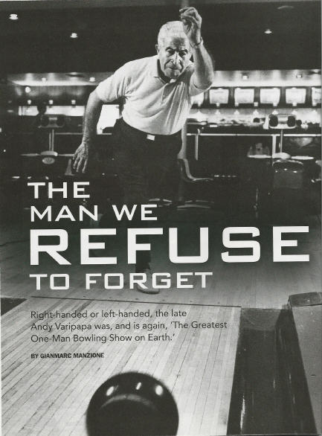
Although Andy passed away over 30 years ago at the age of 93, General Mills featured his trick shots in a 2015 Wheaties ad campaign on both television and the internet. Andy’s trick shots are still captivating audiences long after his death, as evidenced by being voted #1 by PBA fans in the televised trick shot competition held that same year. The exposure introduced Andy to a new generation of fans and inspired Bowlers Journal to write a feature article entitled “The Man We Refuse To Forget.”
To view a video of Andy’s trick shots click this link Bowling Tricks with Andy Varipapa
1955
1983
Photos courtesy of General Mills and Bowlers Journal

